Slide 1

Machine Learning
Practical Presentation
Muhammad Faisal Kamran 2023-BS-AI-025 4th A
01

Slide 2

Project 2: Classification
Credit Score Classification
02

Slide 3
Introduction
In my second project, I have built a credit score classification project
This project aims to build a machine learning model to classify customers' credit scores into three categories: Poor, Standard, or Good.
Credit scoring is crucial for financial institutions to assess the risk of lending money.
The model helps automate creditworthiness evaluation based on financial behavior, income, debt, and payment history
03

Slide 4
Dataset
The dataset contains historical Bitcoin price data from September 17, 2014 to February 19, 2022 (2,713 daily observations) with the following
Key features include
Annual_Income and Monthly_Inhand_Salary
Num_Bank_Accounts, Num_Credit_Card
Interest_Rate
Num_of_Loan and Delay_from_due_date
Num_of_Delayed_Payment
Credit_Mix
Outstanding_Debt
Credit_Utilization_Ratio and Credit_History_Age
Total_EMI_per_month
Monthly_Balance
04

Slide 5
Preprocessing Steps
Outlier Detection and Removal
Train Test Split
Selecting Features and Targets
01
02
03
Removed outliers which are unusual data points using the box plot method. DId this for better generalization and more stable and accurate model performance
Splitting our datatest for training and testing.
Selecting only 12 relevant features
Correlation analysis
04
Statistical method used to evaluate the strength and direction of a relationship between two or more variables
-5

Slide 6
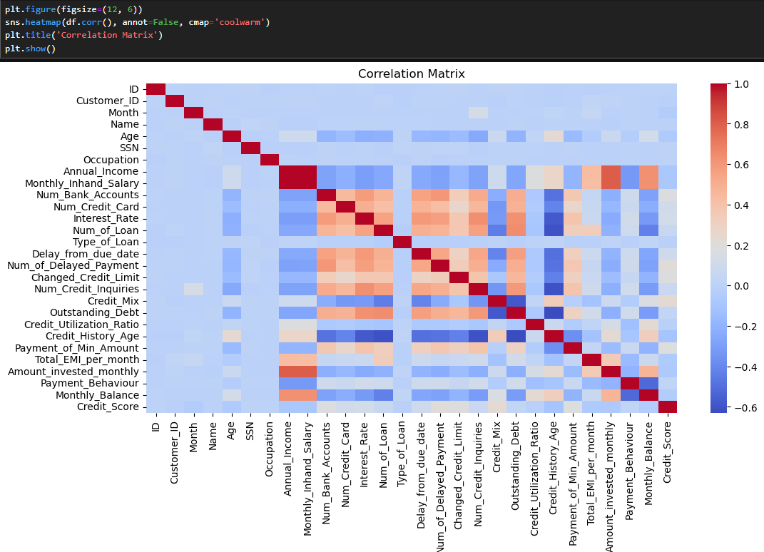
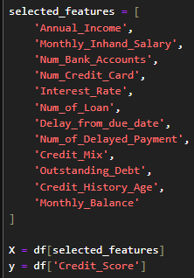
Correlation Matrix
Selected Features and Targets
06

Slide 7
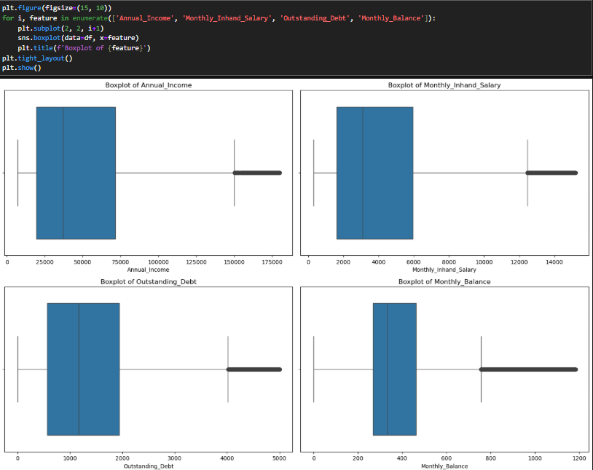

Outlier Detection and Removal
Train Test Split
07

Slide 8
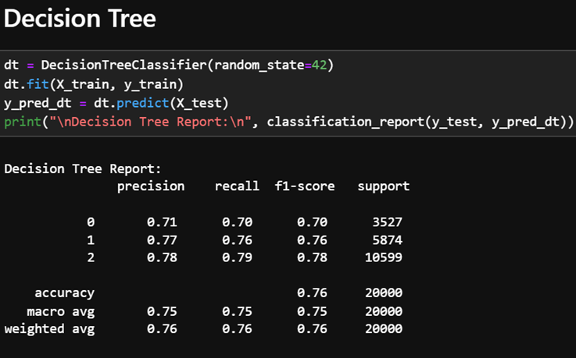
Modeling
For our model we selected Decision tree because of the following
Handles Mixed Data Types
Captures Non-linear Relationships
Interpretability
08

Slide 9
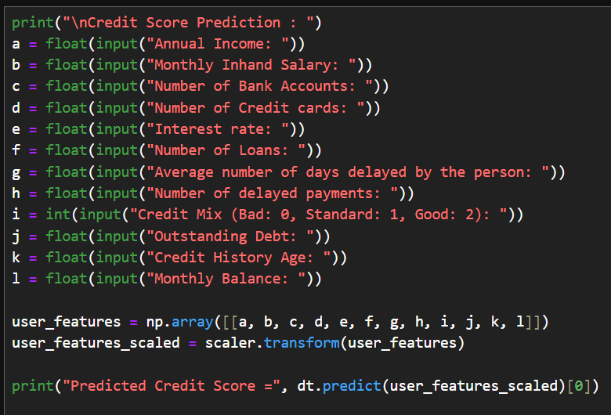
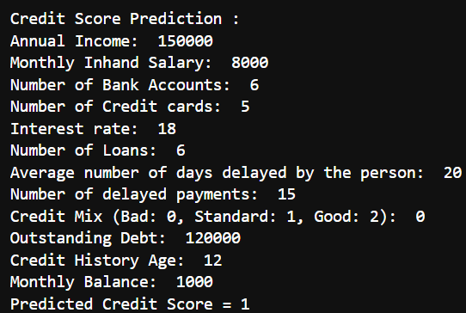
Evaluation
We evalaute and predict thecredit score of a person using our decision tree model
Here 0 score means bad, 1 means standard and 2 means good
Code
Output
09

Slide 10
Key Findings
Dataset Overview:
The dataset contains 100,000 records with 28 features
Key features include Annual_Income, Monthly_Inhand_Salary, Num_Bank_Accounts, Num_Credit_Card, Credit_Mix, Outstanding_Debt, and Credit_Score.
Data Exploration:
The dataset was examined using basic operations like head(), tail(), sample(), and describe() to understand its structure and summary statistics.
The target variable, Credit_Score, has three categories: Good, Standard, and Poor.
Handling Missing Values
Data Visualization:
A countplot was used to visualize the distribution of Credit_Score, showing the frequency of each category.
Feature Selection:
12 relevant features were selected for training and prediction, focusing on financial behavior metrics.
Results
Credit score was classifed for a person as 0(bad), 1 (Standard) and 2(Good)
10

Slide 11
Conclusion
Project demonstrates a well-structured and methodical approach to credit risk modeling, firmly grounded in machine learning best practices.
It features clean and consistent data preprocessing, thoughtful handling of imbalanced classes, and the implementation of multiple models to ensure a comprehensive performance comparison.
The evaluation framework is robust, incorporating both traditional classification metrics and more domain-relevant indicators that reflect the cost-sensitive nature of credit risk assessment
11

